Slide 1

Multilayer GRU on MNIST

Slide 2
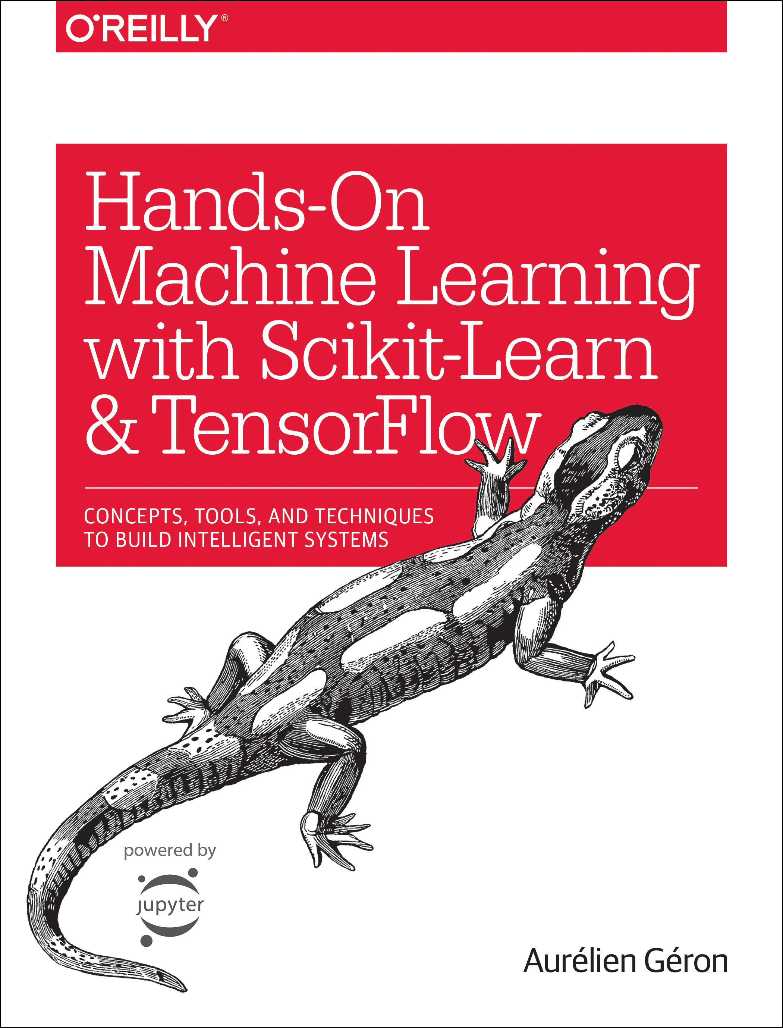
Reference
Chapter 14 (O'Reilly) of Hands-On ML
Youtube on MNIST
Youtube on CNN on MNIST
Youtube on GRU on MNIST
Youtube
Code

Slide 3
Data

Slide 4
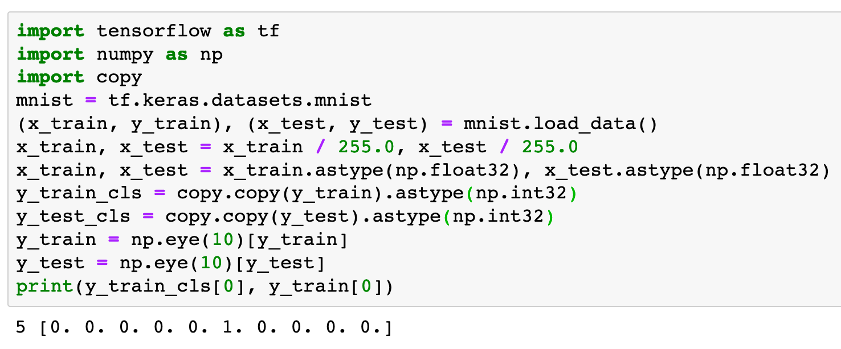

Slide 5
Warm Up

Slide 6
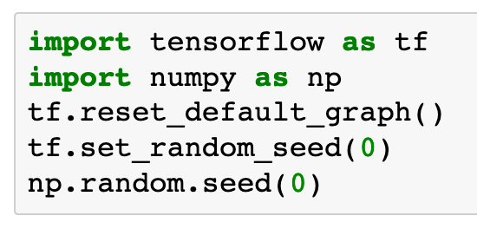

Slide 7
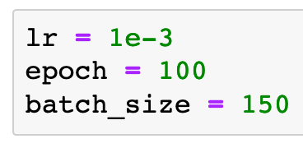

Slide 8
Graph

Slide 9
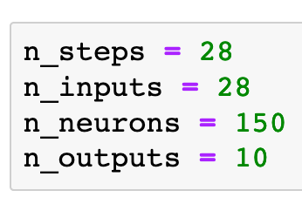
Previously

Slide 10
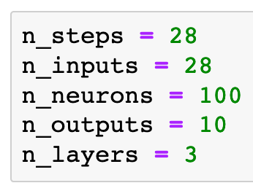
Previously
Now

Slide 11
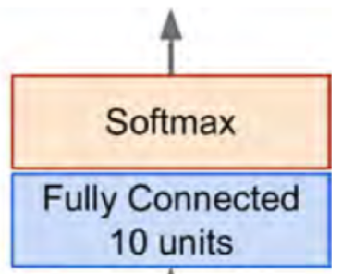
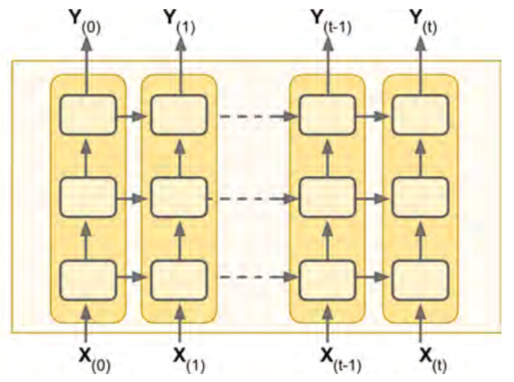
Previously
Now
Chapter 14 (O'Reilly) of Hands-On ML

Slide 12
Chapter 14 (O'Reilly) of Hands-On ML

Slide 13


Chapter 14 (O'Reilly) of Hands-On ML

Slide 14

Chapter 14 (O'Reilly) of Hands-On ML

Slide 15
Chapter 14 (O'Reilly) of Hands-On ML

Slide 16
Chapter 14 (O'Reilly) of Hands-On ML

Slide 17

Chapter 14 (O'Reilly) of Hands-On ML

Slide 18
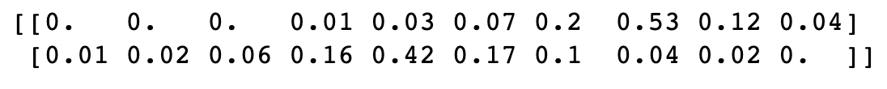
Chapter 14 (O'Reilly) of Hands-On ML

Slide 19
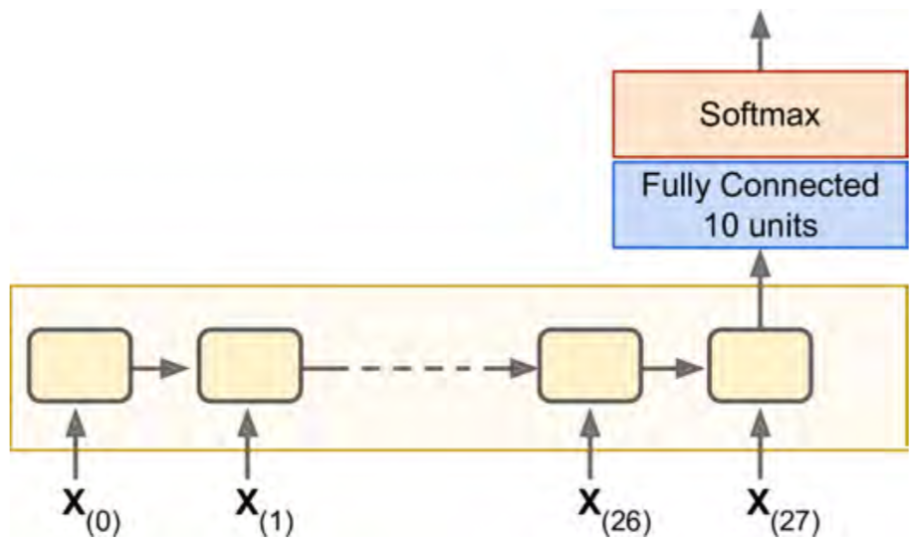
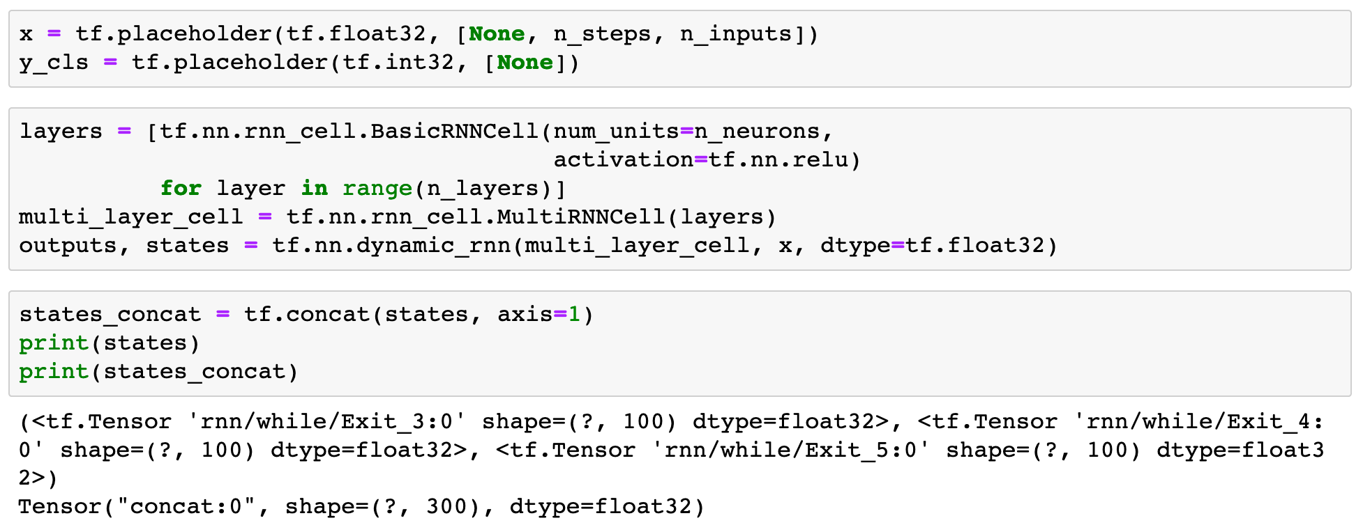

Chapter 14 (O'Reilly) of Hands-On ML

Slide 20
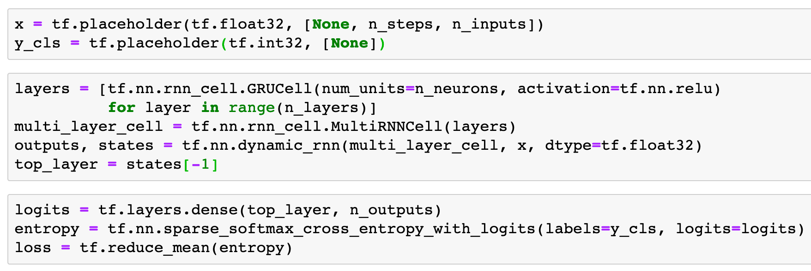
Chapter 14 (O'Reilly) of Hands-On ML

Slide 21
Chapter 14 (O'Reilly) of Hands-On ML
x

Slide 22
Chapter 14 (O'Reilly) of Hands-On ML
(?,28,28)
x

Slide 23
Chapter 14 (O'Reilly) of Hands-On ML
(?,28,28)
x

Slide 24
Chapter 14 (O'Reilly) of Hands-On ML
top_layer
(?,28,28)
x

Slide 25
Chapter 14 (O'Reilly) of Hands-On ML
(?,100)
top_layer
(?,28,28)
x

Slide 26

Chapter 14 (O'Reilly) of Hands-On ML
(?,100)
top_layer
(?,28,28)
x

Slide 27
Chapter 14 (O'Reilly) of Hands-On ML
logits
(?,100)
top_layer
(?,28,28)
x

Slide 28
Chapter 14 (O'Reilly) of Hands-On ML
(?,10)
logits
(?,100)
top_layer
(?,28,28)
x

Slide 29
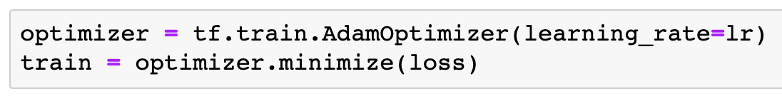

Slide 30
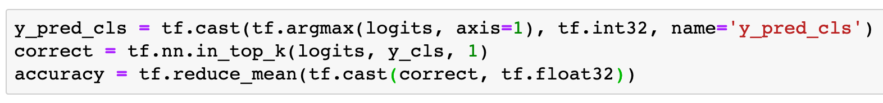

Slide 31
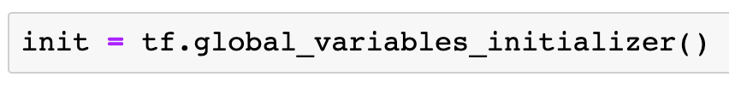

Slide 32
Session

Slide 33
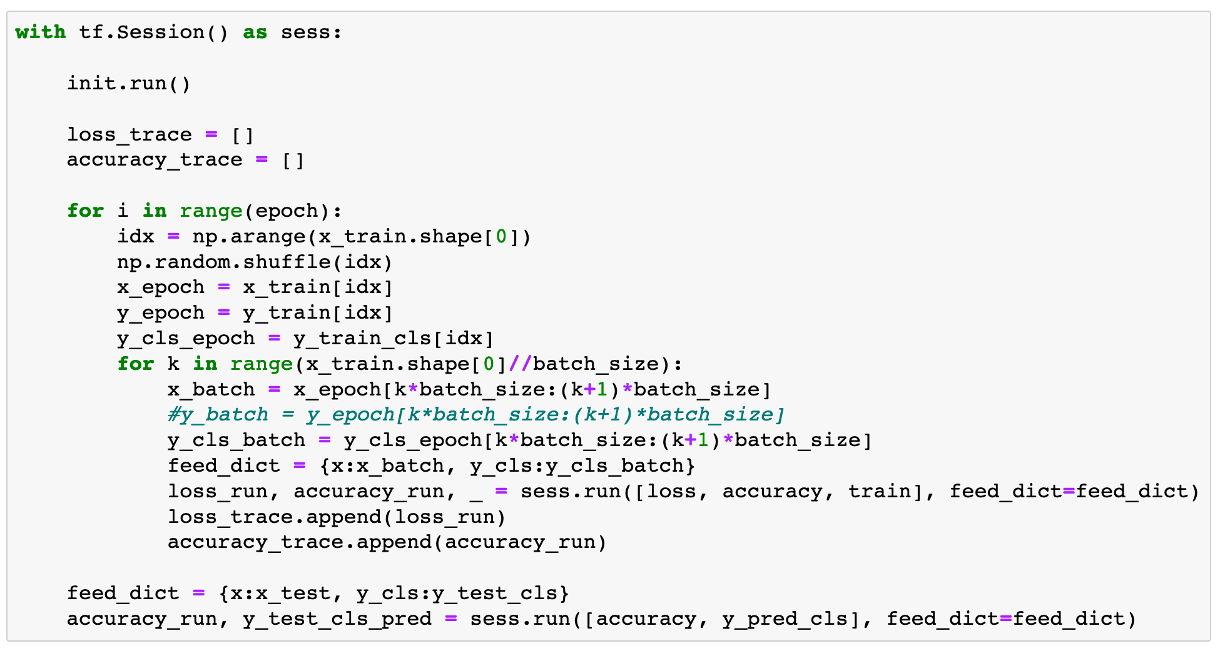

Slide 34
Report Result

Slide 35
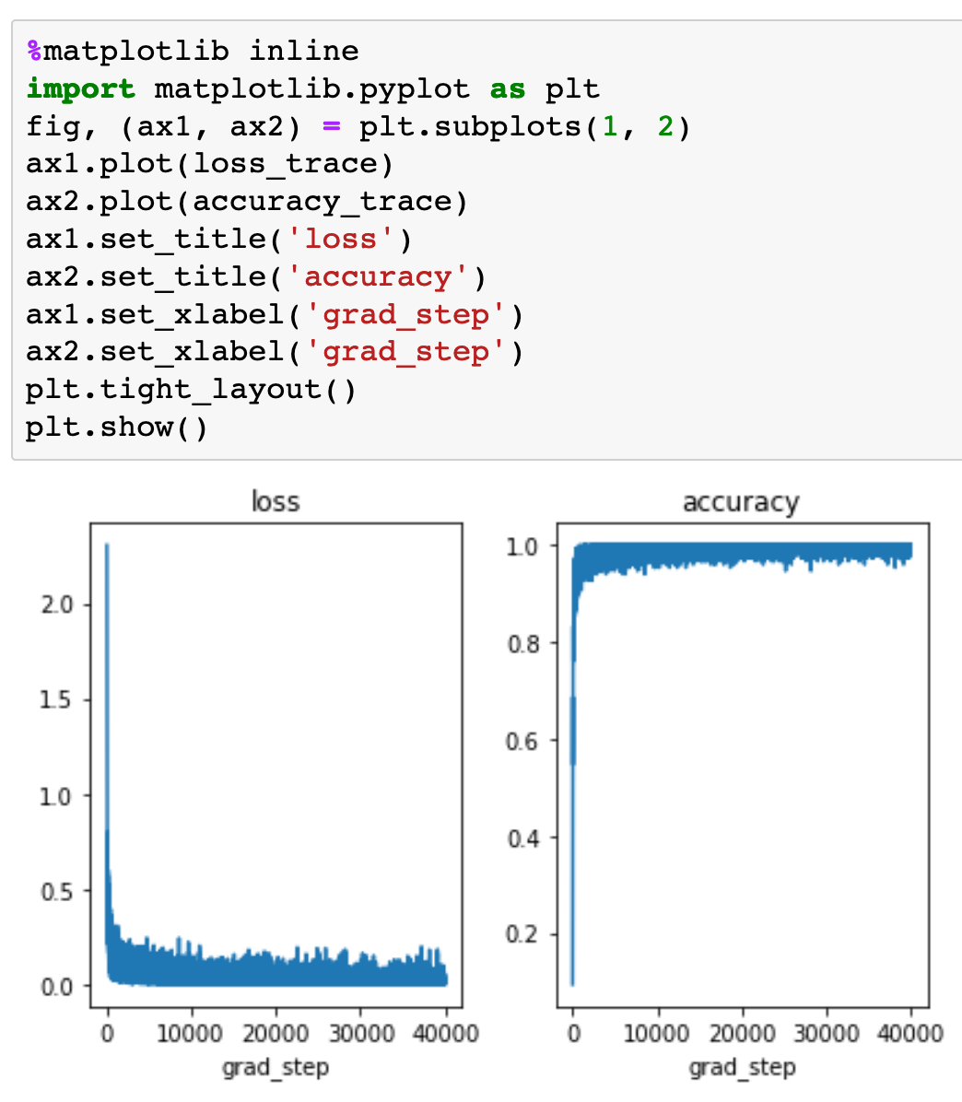

Slide 36
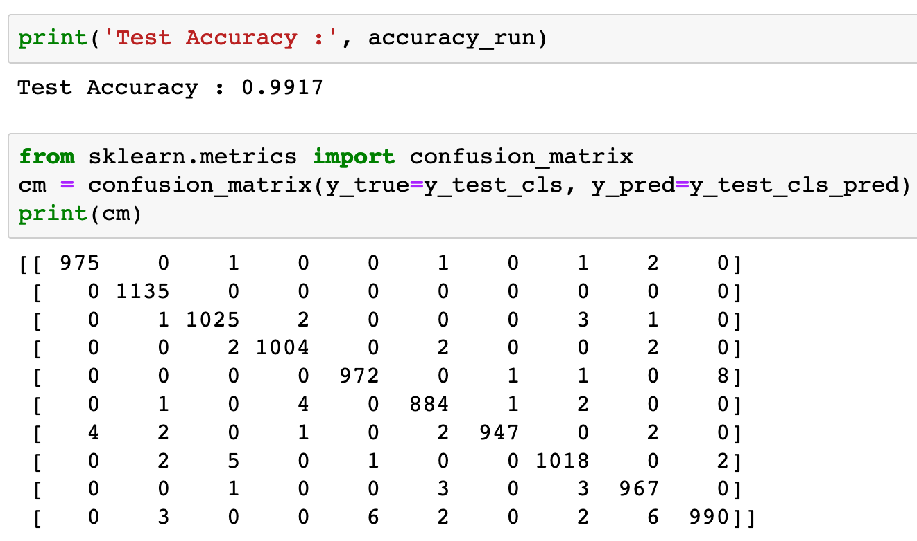
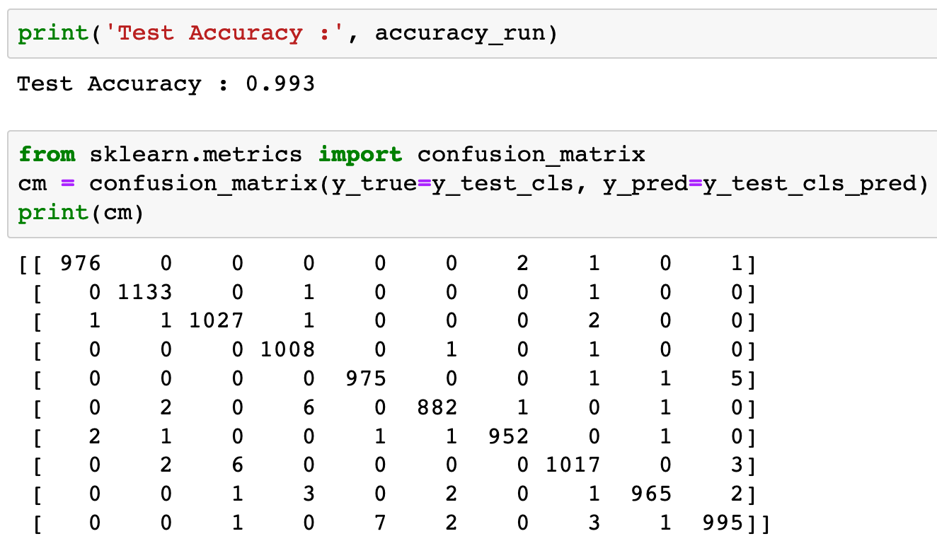


Slide 38
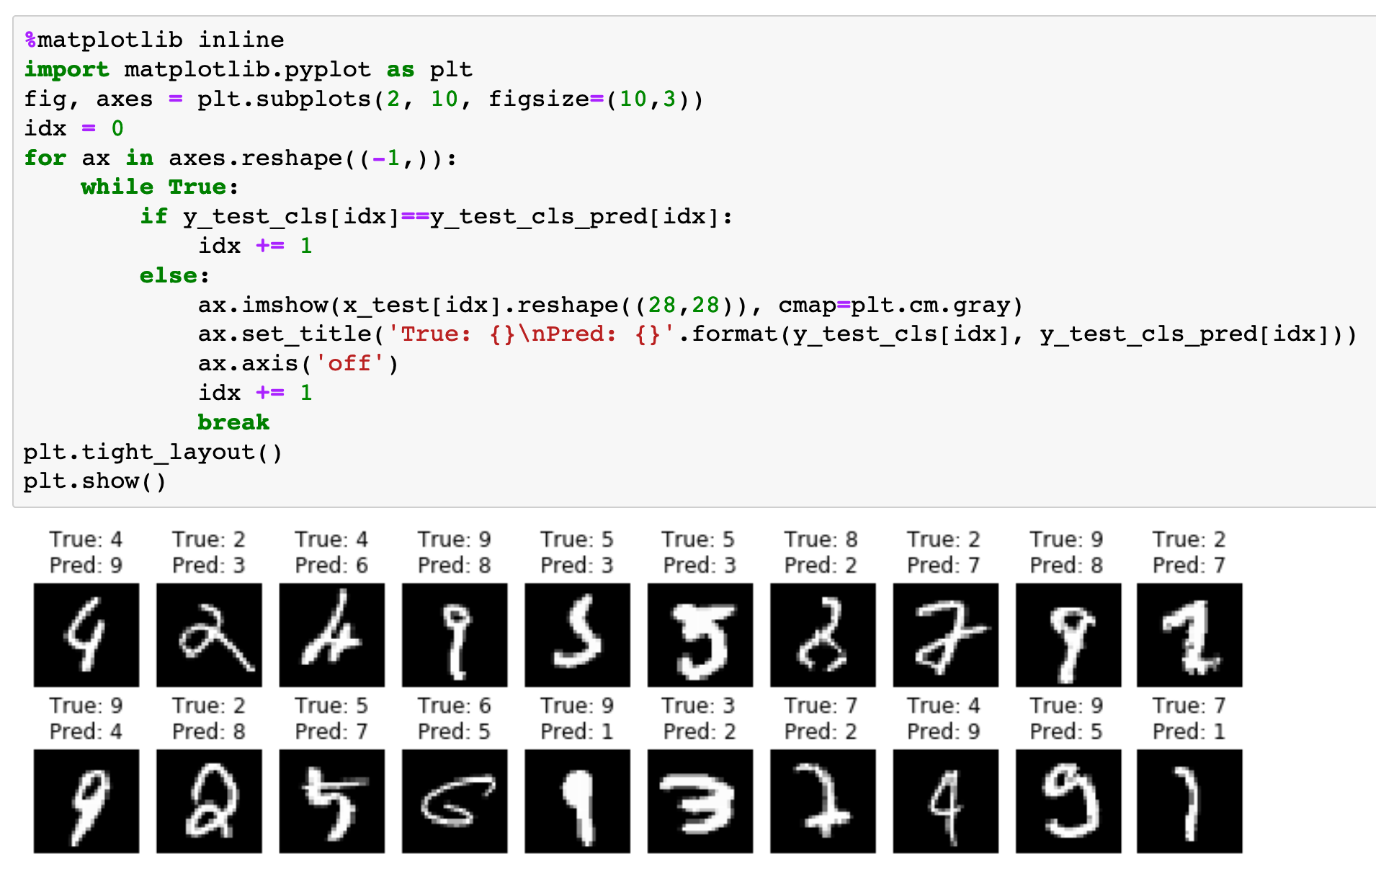

Slide 39
Now
Let’s Play with Code

